Slide 1

CODE LENS ^{2.0}
Enterprise Application Intelligence Platform
“ The Code Analytics AI Agent ”
Team Member : Kaushik Saha, Sameer Kumar Sharma, Sachin Nilawar, Satya Yenamandra, Piyush Gupta, Ullas Krishnan,
Zensar
Hrushikesh Nalawade
Project : AMEX Diamond
Zensar’s in-house AI-driven accelerator

Slide 2
AI-driven code accelerator
Code Lens
CODE LENS
Mapping Demographics
Demographic Field Scanner
Gen AI Analysis
Match Lens
Data Image
Analytics Lens
25-30% efficiency gain in time-to-discovery
Multi-Language Capability
Validation
Code Change
Demographic
Field Finding
Central Documentation
Improved Accuracy
Validator Agent
Field Lens
Page 2 | © Zensar Technologies, 2025

Slide 3


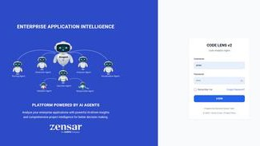
What It Does
Analyzes large, multi-language codebases (1000+ files)
Identifies architectural patterns, dependencies, and data flow
Detects sensitive or regulated demographic data (PII, PHI, Financial, etc.)
Provides AI-powered insights, modernization planning, and compliance validation
Measures code quality and structural compliance
Data Image - Dependency , Function Call, Data Flow
Generates professional visual reports for audits, refactoring, and executive review
CODE LENS v2
Is an enterprise-grade application intelligence platform built to analyze, understand, and modernize complex, multi-language software systems.
It acts as a compliance and modernization companion, combining AI, automation, and visual analytics to detect architectural patterns, dependencies, and sensitive demographic data — all while ensuring complete data privacy through offline operation.

Slide 4




Code Lens Feature- Development Path
Development - Features - Implementation
Gen AI & Agentic Feature
Code Migration
Cloud Optimization
Quality Scan / Measure
CWE ISO
Quality Check
CODE LENS
APPLICATION REFRACTORING
Data Imaging
Function Call Level Dependency Field
Mapping
AI Code Refractor
Analysis Code Architecture and
Dependencies

Slide 5
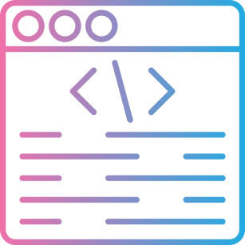

refractor
Intelligently analyzes enterprise application source code to understand software architecture, component interactions, and dependencies.
Enables modernization, optimization, and compliance through automated insights.
re-engineering
rework
AI Agents
Extract architecture, dependencies, and APIs.
Scan entire codebase for demographic/PPI fields.
85% Faster Modernization Analysis
100% Offline & Secure
Code Lens
Quality Measure
Automated Source Code Quality Measurement
ISO/IEC 5055:2021 (measurement )
ISO/IEC 25010 (quality )
CWE (Common Weakness Enumeration)
CWE Security Vulnerability Scanner Rules
Data Imaging
Function Call and Level
Dependency Graph
Data Field Flow Graph
Impact Analysis Graph

Slide 6

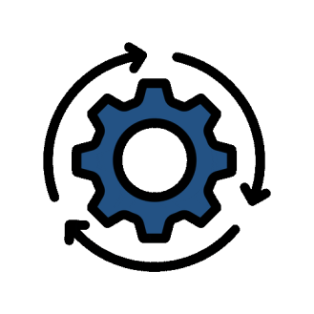
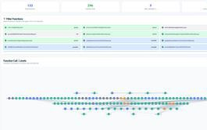
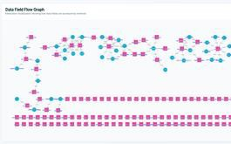
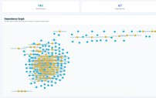
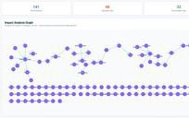
Re Imaging- Data - Architecture Flow
Where does a data field originate?
Which functions and files process or transform it?
What is the downstream impact if it changes?
AI Agent Response
LLM
Data Flow Map
User Prompt
Dependency
Impact Analysis
AI Agent
Function-Level Impact
Function Call and Level
Data Field Flow Graph
Dependency File Level
Impact Analysis Graph
Visualizes how functions interact and depend on each other across different layers of the system.
Tracks the movement and transformation of data fields across processes and components.
A visual representation of file-to-file dependencies within a project. It shows which files import, include, or reference other files.
Shows the ripple effect of changes in code, configuration, or data on other parts of the system.

Slide 7
CodeLens- Efficiency
Comparison: AI vs. Manual Efforts for CodeLens
Aspect | AI-Assisted (CodeLens) | Manual Effort | Difference
Time Taken | ~30 minutes for repo and data lineage analysis | ~8–10 hours of manual tracing and documentation | AI reduces time by ~95%, enabling faster architecture reviews.
Effort | Minimal — setup and validation only | High — continuous manual review and cross-check | Automates repetitive and complex tasks, reducing workload.
Accuracy | High — consistent mapping with reduced human error | Moderate — prone to oversight and inconsistencies | AI ensures consistent, reliable outputs for design decisions.
Scalability | Easily scalable across multiple repos and systems | Limited by team bandwidth and expertise | AI handles large-scale analysis without additional resources.
Cost Efficiency | High — faster turnaround lowers labor cost | Moderate — higher cost due to manual hours | Reduced time and effort translate to significant cost savings.

Slide 8
Summary & Strategic Value
CODE LENS v2 is built as an enterprise modernization accelerator—analyzing millions of lines of code, reducing manual effort by up to 80%, and enabling organizations to migrate from POD (legacy) to POA (modern cloud-native) architectures with confidence.
It unifies code intelligence, compliance scanning, architecture visualization, AI insights, and report generation into a single platform, creating a holistic 360° view of any application.
This provides business and technology leaders with the clarity needed to make fast, accurate modernization decisions with quantified ROI and reduced risk.
The platform is future-ready, with strong emphasis on enterprise AI agents, predictive intelligence, and multi-repository portfolio management — positioning it as a core decision-making engine for modern digital transformation.

Slide 9
Thank you

